Slide 1


Solving the 8-Puzzle with Python: An A* Search Approach
This presentation explores how to solve the classic 8-Puzzle problem using Python and the A* search algorithm, a powerful technique in artificial intelligence for state space search problems. We'll delve into the complexities of the 8-Puzzle, understand the guiding principles of the A* algorithm, and walk through a Python implementation, demonstrating how to find optimal solutions efficiently. Let's unlock the secrets to solving this fascinating puzzle!

Slide 2
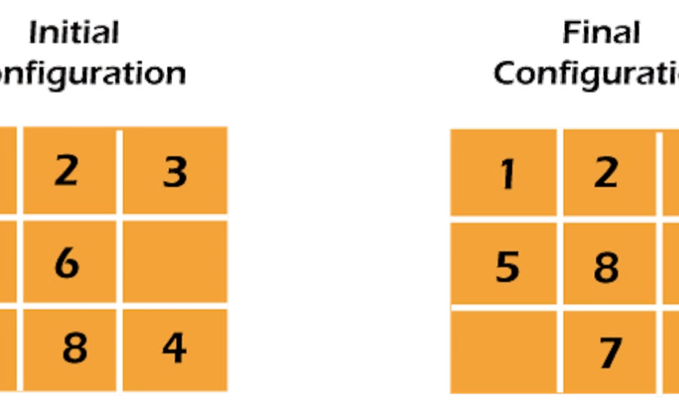
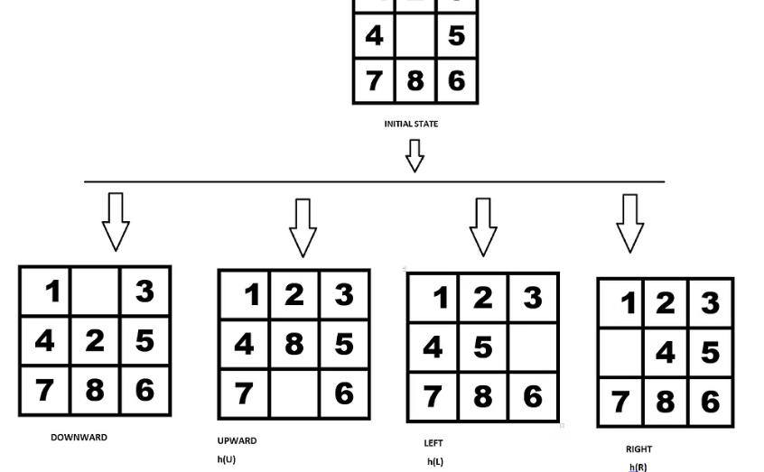
The 8-Puzzle: A Classic AI Problem
Initial State
Goal State
A randomized configuration of the 8-Puzzle board.
The desired arrangement of the 8 numbered tiles.
The 8-Puzzle consists of a 3x3 board containing 8 numbered tiles and a single blank space. The objective is to rearrange the tiles from a given initial state to a predefined goal state by sliding tiles into the blank space. This problem is a valuable testbed for AI algorithms due to its relatively small, but complex, state space, making it ideal for exploring search strategies.

Slide 3
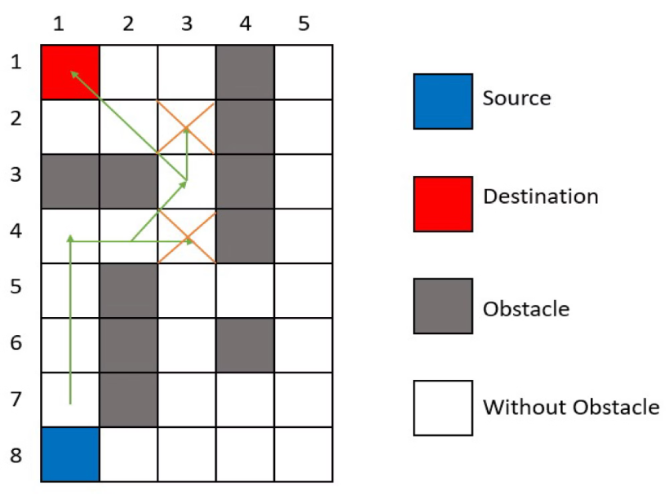
A* Search Algorithm: Guiding Principles
A* search combines uniform cost search and best-first search, utilizing an evaluation function f(n) = g(n) + h(n). g(n) is the cost from the start node to node n, while h(n) is the estimated cost (heuristic) from node n to the goal. The heuristic must be admissible, meaning it never overestimates the actual cost to reach the goal, ensuring optimality. A* efficiently explores the search space by prioritizing nodes with the lowest estimated total cost.

Slide 4
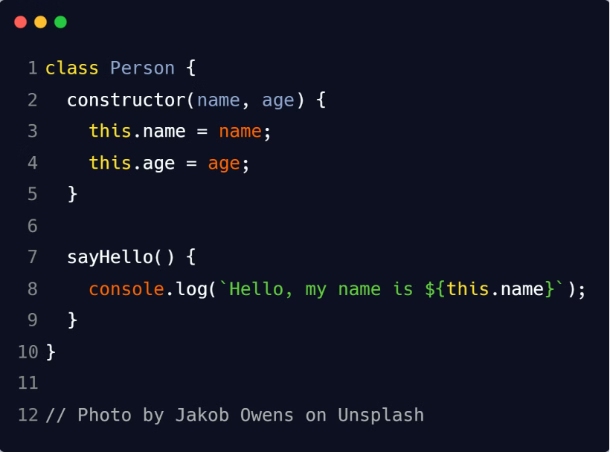
Defining the PuzzleState Class
The `PuzzleState` class represents a state in the 8-Puzzle problem. Key attributes include the `state` (the tile configuration), `parent` (the previous state), `move` (the action taken), `cost` (cost from initial state), and `heuristic` (estimated cost to goal). The `__init__` method initializes these attributes. `__lt__`, `__eq__`, and `__hash__` methods are defined for priority queue comparison, state comparison, and set usage, respectively, which are essential for efficient implementation of the A* search.

Slide 5
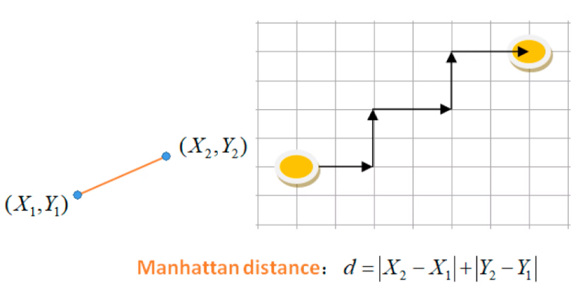
Implementing the Heuristic Function
Heuristic = A smart guess about how far a state is from the goal.
Two common methods:
Manhattan Distance: Adds up how many steps each tile needs to move to be in the correct position.
Hamming Distance: Simply counts how many tiles are in the wrong place.Why Manhattan Distance is good?It never overestimates the number of moves needed.
This ensures the A* algorithm (a search method) finds the best possible solution.

Slide 6



Generating Possible Moves
Generating valid moves involves finding the position of the blank tile and determining the possible directions (up, down, left, right) it can be moved. Neighboring states are generated by swapping the blank tile with the tile in the chosen direction. The code ensures that these moves stay within the board boundaries, preventing illegal moves and keeping the search within the valid state space. Valid moves are critical to exploring the puzzle's solution space effectively.

Slide 7
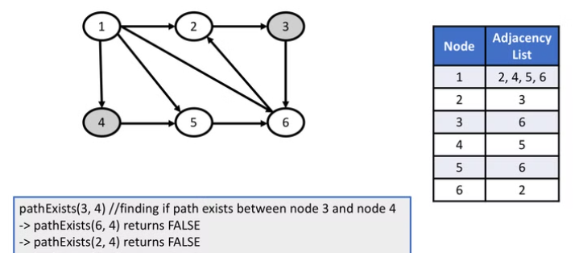
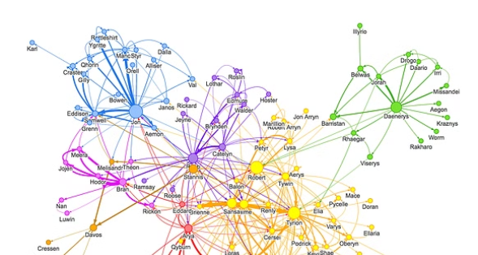

Expanding the Search Space
The expand_state function helps in solving the 8-puzzle problem by generating possible next moves.
What does it do?
It takes a puzzle state (the current arrangement of tiles).
It finds all possible moves by shifting the empty tile.For each move, it creates a new puzzle state.
Why is it useful?
It helps explore different ways to solve the puzzle.Each move is assigned a cost (usually 1 move = 1 cost).It builds a "search tree," which helps algorithms like A* find the best solution.

Slide 8

A* Search Implementation in Python
What does it do?
It finds the best way to solve the 8-puzzle using the A* algorithm.
It uses a priority queue (a list that always picks the best move first).
It keeps track of visited states so it doesn’t check the same move again.
Why is it useful?
It avoids wasting time on bad or repeated moves.
It quickly finds the shortest path to solve the puzzle.
Once the puzzle is solved, it traces back to show all the steps needed..

Slide 9
Running the Solver and Analyzing Results
States Explored
~100-1000 (varies with initial state)
Execution Time
< 1 second
The solver's performance is evaluated based on the number of states explored and the execution time. Optimizations such as using a more efficient data structure for the `closed_set` (e.g., a hash set) can further improve performance. A* guarantees solution optimality, meaning it finds the shortest sequence of moves to solve the puzzle. Analyzing these metrics provides insights into the algorithm's efficiency and effectiveness.

Slide 10


Conclusion: A* for the 8-Puzzle
This slide explains how the A (A-star) search algorithm* is used to solve the 8-Puzzle problem (a puzzle where you move tiles to arrange them in order).Simple Explanation:A search* is a smart way for a computer to find the best solution to a problem.It works by looking at both the current cost and the estimated cost to reach the goal.This makes it very efficient in solving puzzles, finding paths in games, and even helping in robotics and logistics (like planning deliveries

